Slide 1

Metaverse & its Societal Impacts
Department of Computer Science and Engineering
VII Semester, B.E
Code: CSSE
By
Gaurav v
1MS18CS046
Under the Guidance of
Mrs. Chandrika prasad
Notes:
Good afternoon everyone, my name is Gaurav V, my USN is 1ms18cs046 and my topic for todays seminar is
Metaverse and it’s societal impacts

Slide 2
Agenda
Introduction
Literature Review
Details of Existing Models
Applications
Gap Analysis
Conclusion
References
Notes:
The agenda for today is to go over what the metaverse is, look at the results from the literature survey conducted, view the existing models of the metaverse and go over it’s applications and give a short analysis of where metaverse is in today’s world and where it is headed to.

Slide 3
Introduction : What is the metaverse ?
An internet you are not just looking at through a screen but you are actually inside of.
It's a combination of multiple elements of technology, including virtual reality, augmented reality and video where users "live" within a digital universe. Supporters of the metaverse envision its users working, playing and staying connected with friends through everything from concerts and conferences to virtual trips around the world.
Technologies that make up the metaverse can include virtual reality—characterized by persistent virtual worlds that continue to exist even when you're not playing—as well as augmented reality that combines aspects of the digital and physical worlds.
At its core, the metaverse is an evolution of our current Internet.
Notes:
The metaverse has been a hot topic of conversation recently, with big companies like Facebook and Microsoft both staking claims. But we need to know what is the metaverse? And when will it get here?
Inklings of the metaverse already exist in online game universes such as Fortnite, Minecraft and Roblox. And the companies behind those games have ambitions to be part of the evolution of the metaverse.
Our world is undergoing a major disruption with elements like artificial intelligence (AI), virtual reality (VR), augmented reality (AR) and the next version of internet taking over our lives like never before. Technology is changing at a rapid pace and the line between reality and virtual reality is set to get thinner in the near future.
So lets get right into it, What is the metaverse?
An internet you are not just looking at through a screen but you are actually inside of.
It's a combination of multiple elements of technology, where users "live" within a digital universe. Supporters of the metaverse envision its users working, playing and staying connected with friends through everything from concerts and conferences to virtual trips around the world.
Broadly speaking, the technologies that make up the metaverse can include virtual reality—characterized by persistent virtual worlds that continue to exist even when you're not playing—as well as augmented reality that combines aspects of the digital and physical worlds. However, it doesn't require that those spaces be exclusively accessed via VR or AR only. A virtual world, like aspects of Fortnite can be accessed through PCs, gaming consoles, and even phones, which in essence could be metaversal.
At its core, the metaverse is an evolution of our current Internet and is going to built using the new web 3 concepts.

Slide 4
Introduction : The economy of metaverse
A digital economy : users can create, buy, and sell goods. And, in the more idealistic visions of the metaverse, it's interoperable, allowing you to take virtual items like clothes or cars from one platform to another.
Most platforms have virtual identities, avatars, and inventories that are tied to just one platform, but a metaverse might allow you to create a persona that you can take everywhere as easily as you can copy your profile picture from one social network to another.
Notes:
Now let's look at the economy of the metaverse
The Metaverse translates to a digital economy, where users can create, buy, and sell goods. And, in the more idealistic visions of the metaverse, it's interoperable, allowing you to take virtual items like clothes or cars from one digital metaversal platform to another.
In the real world, you can buy a shirt from the mall and then wear it to a movie theatre. Right now, most platforms have virtual identities, avatars, and inventories that are tied to just one platform, but a metaverse might allow you to create a persona that you can take everywhere as easily as you can copy your profile picture from one social network to another.

Slide 5
Literature Review
A total of 10 papers, from established publishers and authors were reviewed.
The survey of existing work can be summarised under 3 categories.
- Effect of metaverse as a form of escapism
- Metaverse as a beneficial psychological tool for therapy
- The lack of real feedback and senses in the Metaverse
Notes:
For the literature survey a total 10 papers were reviewed from well established authors and publishers.
The survey of existing work can be summarised under 3 categories.
- First, the Effect of metaverse as a form of escapism
- Second, Metaverse as a beneficial psychological tool for therapy
And finally The lack of real feedback and senses in the Metaverse
I will be speaking more about each of the categories in the next few slides

Slide 6
Literature Review : Effect of metaverse as a form of escapism
Humans are social mammals, we love and need to communicate regularly. Social medias give humans means to express ourselves and receive instantaneous reaction from friends.
The emergence of virtuality technology will bring new possibilities for human interaction. Virtual Reality (VR) are predictable to give an enormous impact on daily life.
According to a Cisco report VR and AR experience could be involved in peoples day-to-day lives and found that it can be more like an experience where the virtual environment and software applications get into a normal day-to-day routine.
In the virtual world, it is only the spatial presences, it can trick the brain to believe in virtual
Notes:
Humans are social mammals, we love and need to communicate regularly. Social medias give humans means to express ourselves and receive instantaneous reaction from friends.
The emergence of virtuality technology will bring new possibilities for human interaction. Therefore, the combination of these technologies with social networks seem unavoidable. Virtual Reality (VR) are predictable to give an enormous impact on daily life.
According to a Cisco report VR and AR experience could be involved in peoples day-to-day lives and found that it can be more like an experience where the virtual environment and software applications get into a normal day-to-day routine.
The immersive technologies could lead to loneliness and escapism. In the virtual world, it is only the spatial presences, it can trick the brain to believe in the virtual.

Slide 7
Literature Review : Effect of metaverse as a form of escapism
Escapism is defined as the act of withdrawing from the problems of the real world into imaginary worlds. In the digital age, the real appears with the virtual.
Good escapism allows people escape from a narrow world into a broader one, allowing your mind to travel to the place that the body cannot go.
Bad escapism is when one escapes from the possibility of a broader world into a narrower or safer one, to avoid taking difficult actions & decisions.
Notable aspects of unhealthy escapism are
• Procrastination
• Psychosis
• Denial
• Addiction
Notes:
Escapism is defined as the act of withdrawing from the problems of the real world into imaginary worlds. In the digital age, the real appears with the virtual.
Good escapism allows people escape from a narrow world into a broader one, allowing your mind to travel to the place that the body cannot go.
Bad escapism is when one escapes from the possibility of a broader world into a narrower or safer one, to avoid taking difficult actions & decisions.
The escapism can be considered as unhealthy depending on how much escapism a person indulges in and how extensive that world is away from reality.
Notable aspects of unhealthy escapism are
• Procrastination: an escapism where people stop working hard or putting effort into something and try to delay tasks as much as possible
• Psychosis: a situation where a person gets confused with the boundaries between what is real and what is not.
• Denial: people isolating themselves because of the built illusion layer and the unwillingness to grasp reality around them
• Addiction: a scenario where people are not capable of control their own habits.

Slide 8
Literature Review : Metaverse as a beneficial psychological tool for therapy
Augmented and virtual reality (AR/VR) technologies are regularly used in psychology research to complement psychological interventions and to enable an individual to feel as if they are in an environment other than that of their immediate surroundings.
New research directions in personalized mental health virtual reality (VR) therapy are proposed, particularly in the areas of prevention and treatment of stress-related disorders.
Personalized estimation of the patient’s emotional state is based on appropriate artificial neural network algorithms, which integrate various features of the patient’s multimodal response, like autonomic physiology, voice, and facial expressions.
Notes:
Augmented and virtual reality (AR/VR) technologies are regularly used in psychology research to complement psychological interventions and to enable an individual to feel as if they are in an environment other than that of their immediate surroundings.
New research directions in personalized mental health virtual reality (VR) therapy are proposed, particularly in the areas of prevention and treatment of stress-related disorders.
Personalized estimation of the patient’s emotional state is based on appropriate artificial neural network algorithms, which integrate various features of the patient’s multimodal response, like autonomic physiology, voice, and facial expressions.
This approach is in line with personalized psychiatry, with potential to significantly improve psychological and biological state of the patient in the larger framework of Psychiatry for the Person.

Slide 9
Literature Review : The lack of real feedback and senses in the Metaverse
One sense that can deepen our experience of many situations is touch.
Using haptic devices to deliver the simulation of touch between users via sensors and machine learning for emotion recognition based on data collected help in working towards simulated closeness in communication despite the physical distance or being in VR.
Notes:
One of the main senses that can deepen our experience in either the virtual or real world many situations is touch. It is very important to integrate it into the Metaverse for a better user experience.
Using haptic devices to deliver the simulation of touch between users via sensors and machine learning for emotion recognition based on data collected help in working towards simulated closeness in communication despite the physical distance or being in the Metaverse.

Slide 10
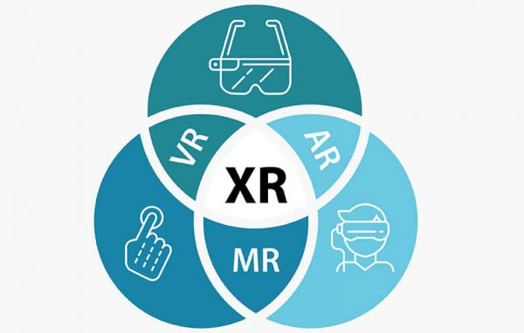
Details of Existing Models
Extended reality (XR) is a term referring to all real-and-virtual combined environments and human-machine interactions generated by computer technology and wearables.
XR is an emerging umbrella term for all the immersive technologies. The ones we already have today—augmented reality (AR), virtual reality (VR), and mixed reality (MR) plus those that are still to be created.
The Metaverse follows the XR model, where all 3 realities merge to form one complete experience.
Notes:
Now talking about the existing models, Metaverse is built on the existing model of extended reality.
Extended reality (XR) is a term referring to all real-and-virtual combined environments and human-machine interactions generated by computer technology and wearables.
XR is an emerging umbrella term for all the immersive technologies. The ones we already have today—augmented reality (AR), virtual reality (VR), and mixed reality (MR) plus those that are still to be created.
In augmented reality, virtual information and objects are overlaid on the real world. This experience enhances the real world with digital details such as images, text, and animation. You can access the experience through AR glasses or via screens, tablets, and smartphones.
In contrast to augmented reality, in a virtual reality experience, users are fully immersed in a simulated digital environment. Individuals must put on a VR headset or head-mounted display to get a 360 -degree view of an artificial world that fools their brain into believing they are, e.g., walking on the moon, swimming under the ocean.
In mixed reality, digital and real-world objects co-exist and can interact with one another in real-time. This is the latest immersive technology and is sometimes referred to as hybrid reality. It requires an MR headset and a lot more processing power than VR or AR. Microsoft's HoloLens is a great example for it.
The Metaverse follows the XR model, where all 3 realities merge to form one complete experience.

Slide 11
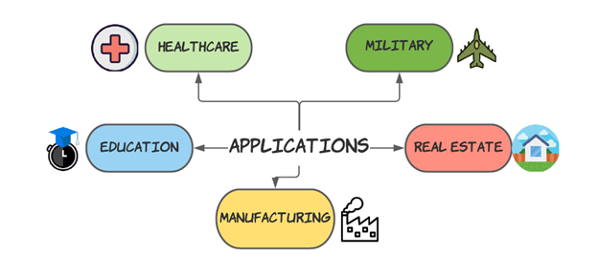
Applications
Notes:
The Metaverse has multiple applications ranging from the Healthcare sector to the real estate sector.
In the next few slides I’ll be taking a deeper dive into each of these applications.

Slide 12
Applications
Healthcare : The deployment of augmented reality in the healthcare sector has a substantial value in training and strengthening the skills and knowledge base of future medical professionals. Surgical assistive tools are technology like the Microsoft Hololens that surgeons utilize to help them with and speed surgical procedures.
Military Applications : Tactical Augmented Reality (TAR) is a technology that appears similar to night-vision goggles (NVG), but it has many more capabilities. It may display a soldier’s precise location as well as the positions of ally and hostile forces. The system is attached to the helmet in the same manner that the goggles are, and it may be used at any time of day or night. As a result, TAR effectively substitutes the standard handheld GPS gadget and eyewear.
Notes:
Healthcare : The deployment of augmented reality in the healthcare sector has a substantial value in training and strengthening the skills and knowledge base of future medical professionals. Surgical assistive tools are technology like the Microsoft Hololens that surgeons utilize to help them with and speed surgical procedures.
Military Applications : Tactical Augmented Reality (TAR) is a technology that appears similar to night-vision goggles (NVG), but it has many more capabilities. It may display a soldier’s precise location as well as the positions of ally and hostile forces. The system is attached to the helmet in the same manner that the goggles are, and it may be used at any time of day or night. As a result, TAR effectively substitutes the standard handheld GPS gadget and eyewear.

Slide 13
Applications
Real estate : The capacity to give potential clients a realistic and immersive experience is VR’s greatest strength. Real estate marketers may take advantage of this power by allowing clients to ultimately see the property before making a choice. Several multimedia features, such as ambient music, narration, and light-and-sound effects, can also be included in specific VR tours.
Education : Traditional teaching approaches will never attain such a high level of effectiveness in highlighting concepts through visuals. Regardless of their age, students will always choose to sit and watch something rather than read it. Virtual reality technology is fascinating because it can produce incredible experiences that could never be “experienced” in real life. With the usage of this technology, students will be more motivated to learn.
Notes:
Real estate : The capacity to give potential clients a realistic and immersive experience is VR’s greatest strength. Real estate marketers may take advantage of this power by allowing clients to ultimately see the property before making a choice. Several multimedia features, such as ambient music, narration, and light-and-sound effects, can also be included in specific VR tours.
Education : Traditional teaching approaches will never attain such a high level of effectiveness in highlighting concepts through visuals. Regardless of their age, students will always choose to sit and watch something rather than read it. Virtual reality technology is fascinating because it can produce incredible experiences that could never be “experienced” in real life. With the usage of this technology, students will be more motivated to learn.

Slide 14
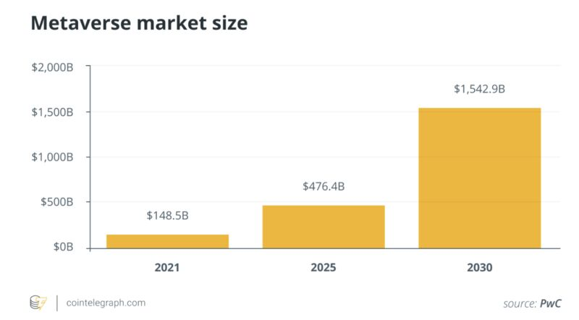
Gap Analysis
The Metaverse is still in its nascent stage but it has a huge scope for growth.
Recent surveys and studies have shown Metaverse Market to Witness Promising Growth to Reach a market value of $1.5 Billion by the year 2030.
Developing Metaverse Platforms for Education and entertainment Sector may Open Avenues for the Market.
The Metaverse is likely to produce trillions in value as a new computing platform or content medium. In its full version it becomes the gateway to most digital experiences, a key component of all physical ones, and the next great platform.
Notes:
Coming to gap analysis The Metaverse is still in its nascent stage but it has a huge scope for growth.
Recent surveys and studies have shown Metaverse Market to Witness Promising Growth to Reach a market value of $1.5 Billion by the year 2030.
This is a significant shift in the digital world that looks and feels reminiscent of the social media revolution back in 2007.
One catch to this tech growth spurt is that it’s happening much quicker and is far more intense.
Developing Metaverse Platforms for Education and entertainment Sector may Open Avenues for the Market.
The Metaverse is likely to produce trillions in value as a new computing platform or content medium. In its full version it becomes the gateway to most digital experiences, a key component of all physical ones, and the next great platform.

Slide 15
Conclusion
Technology sets the direction of modern history and defines it.
The Metaverse is still in its nascent stage but it has a huge scope for growth.
The Bright Side of the Metaverse is that it will allow people to experience an endless virtual world, where they can do things they only dreamed of using an avatar.
The Dark Side of the Metaverse In my perspective, is the separation that will happen between people and reality. It is that perspective in which technology fully catches human attention, distracting us from the real world completely.
How Metaverse will impact our lives, depends a lot on us, on how we will use it. Just like with the other innovations some will use the metaverse for good and others, for bad things.
Notes:
Technology sets the direction of modern history and defines it.
The Metaverse is still in its nascent stage but it has a huge scope for growth.
The Bright Side of the Metaverse is that it will allow people to experience an endless virtual world, where they can do things they only dreamed of using an avatar.
I believe the metaverse can have the following pros:
bring people together
create lots of fun
offer that mysterious aura of alien worlds
make everything more enjoyable and more interesting
improve work at home and home schooling
The Dark Side of the Metaverse In my perspective, is the separation that will happen between people and reality. It is that perspective in which technology fully catches human attention, distracting us from the real world completely.
In my opinion, the metaverse can have the following cons:
generate addiction
make you lose track of time
separate you from the real nature and the real world
overstimulate your senses
How Metaverse will impact our lives, depends a lot on us, on how we will use it. Just like with the other innovations some will use the metaverse for good and others, for bad things.
We are experiencing the beginning of the next step in our history. Let’s embrace it! Thank you .

Slide 16
References
Barker, Darlene & Levkowitz, Haim. (2021). Emotions in Virtual Reality. 39-46. 10.5121/csit.2021.112204.
Carroll, Joanne & Hopper, Louise & Farrelly, Aaron & Lombard-Vance, Richard & Bamidis, Panagiotis & Konstantinidis, Evdokimos. (2021). A Scoping Review of Augmented/ Virtual Reality Health and Wellbeing Interventions for Older Adults: Redefining Immersive Virtual Reality. Frontiers in Virtual Reality. 2. 10.3389/frvir.2021.655338.
Cosic, Kresimir & Popovic, Sinisa. (2012). Virtual reality in personalized mental health medicine.
Siricharoen, Waralak. (2019). The Effect of Virtual Reality as a form of Escapism.
https://medium.com/geekculture/the-metaverse-pros-cons-8d16714c4295

